Slide 1
Secure data hiding in images using steganography
CAPSTONE PROJECT
Presented By: Diya HirenKumar Brahmbhatt
Student Name : Diya HirenKumar Brahmbhatt
College Name & Department : GTU-SET ME (Cyber Security)

Slide 2
OUTLINE
Problem Statement
Technology used
Wow factor
End users
Result
Conclusion
Git-hub Link
Future scope

Slide 3
Problem Statement
With growing cyber threats, traditional encryption is easily detectable. This project implements image steganography to securely hide data within images while maintaining their original appearance. A passcode-based system ensures only authorized users can extract the hidden data. The method enhances security, imperceptibility, and robustness against compression or resizing.

Slide 4
Technology used
Python – Programming language for implementation.
OpenCV (cv2) – Image processing library.
OS Module – For handling file operations
String & Dictionary Operations – For message encoding and decoding

Slide 5
Wow factors
Invisible Communication: The message is hidden within an image, making it undetectable.
Passcode Protection: Ensures only authorized users can retrieve the hidden message.
User-Friendly: Simple console-based input for encryption and decryption.
Custom Encoding: Uses pixel manipulation instead of traditional encryption.

Slide 6
End users
Cybersecurity Enthusiasts – Learning steganography techniques.
Journalists & Activists – Hiding sensitive information.
Forensic Experts – Securely transmitting hidden messages.
General Users – Securing personal information within images.

Slide 7
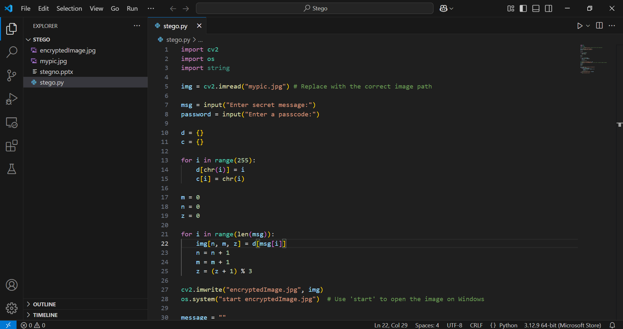
Results

Slide 8
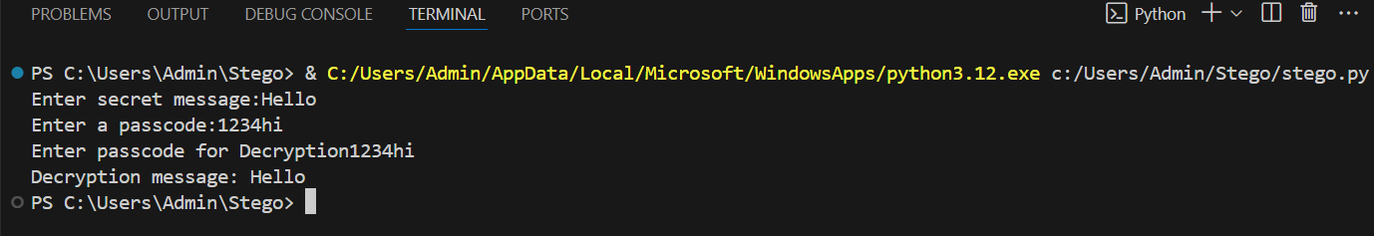
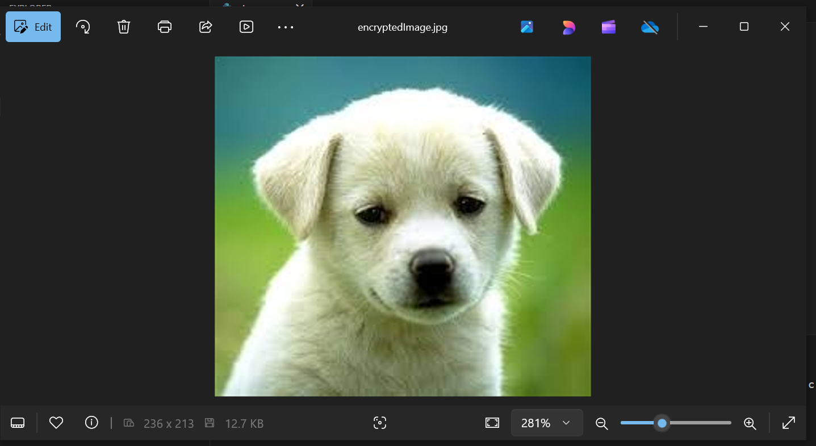
Results

Slide 9
Conclusion
This project demonstrates a simple yet effective way of using image steganography for secure communication. By embedding messages within pixel values, users can conceal information in an unsuspecting medium. However, improvements can be made to enhance security and efficiency.

Slide 10
GitHub Link
https://github.com/Diya2705/stego.git

Slide 11
Future scope(optional)
Enhanced Encryption: Integration with AES-256 for stronger security.
Audio & Video Steganography: Extending the concept to hide data in multimedia files.
Cloud Integration: Secure image storage and retrieval over cloud services.
Machine Learning for Detection Prevention: Using AI to make steganographic images harder to detect.
Blockchain-Based Authentication: Ensuring tamper-proof verification of hidden messages.

Slide 12
THANK YOU

